Slide 1
STYLE.CSS

Slide 2
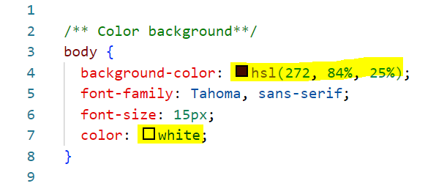
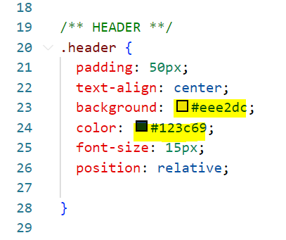
Line 4: Change background color code
Line 7: Change font color
Line 23: Change color code same as background color
Line 24: Change font color same as font color above

Slide 3
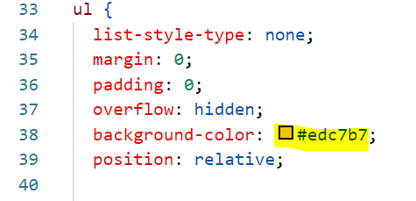
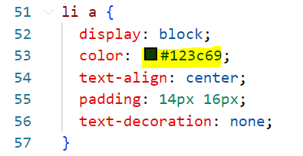
Line 38: Change bg for menu
Line 53: Change for color in menu

Slide 4
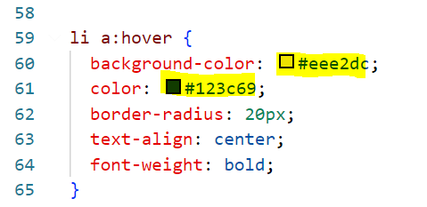
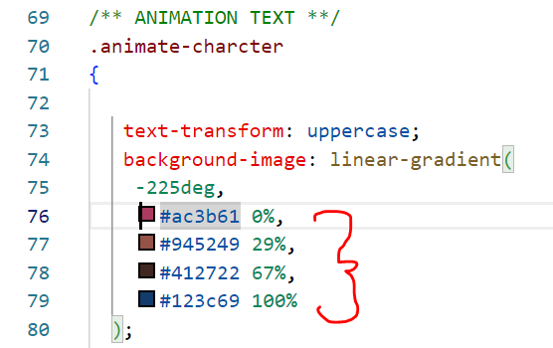
Line 60: Change background color for menu when cursor move to the link
Line 52:Change font color for menu when cursor move to the link
Line 76-79: You can change to your favorite color for title effect

Slide 5
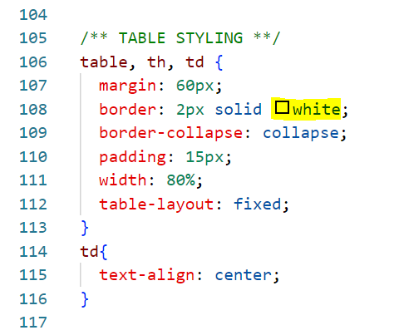
Line 108: change color of table border

Slide 6
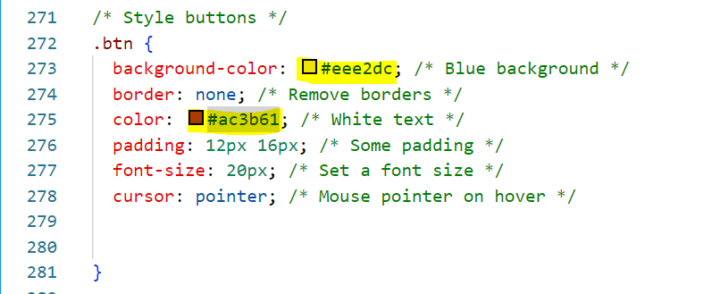
Line 273: Change color same as menu background color
Line 275: Color for icon home

Slide 7
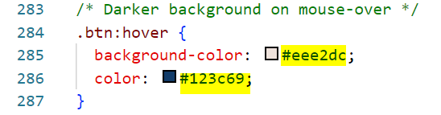
Line 285: used the same background color
Line 286: color change when cursor near/hit the home icon

Slide 8
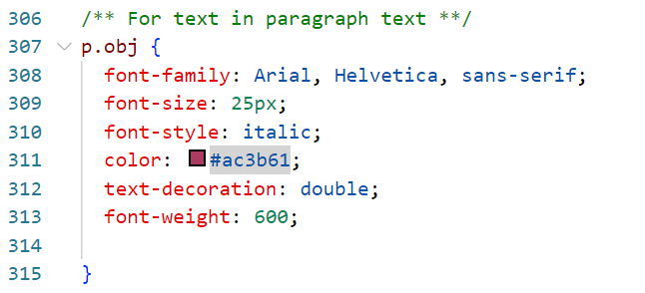
Line 311: background color for text

Slide 9
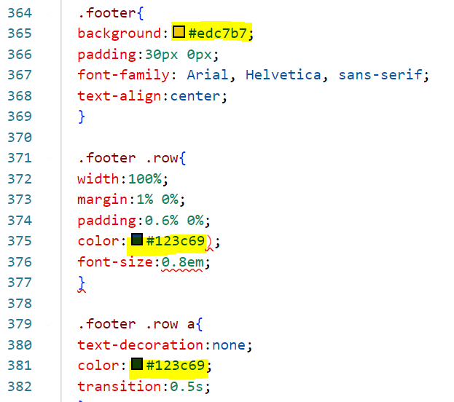
Line 365: footer background color, color must same as navigation bar
Line 375 & 381: Font color in footer section, same color as font in navigation bar

Slide 10
INDEX.HTML

Slide 11
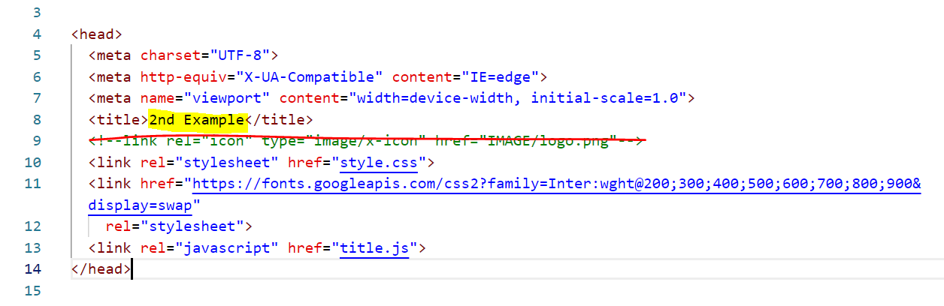
Line 8: Rename your title page
Line 9: Remove all

Slide 12

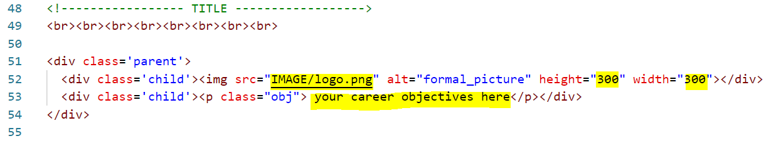
Line 19: Add your header either in form of image or text
Line 52: Insert your image, adjust height and width based on your preference
Line 53: Insert your Career objectives

Slide 13
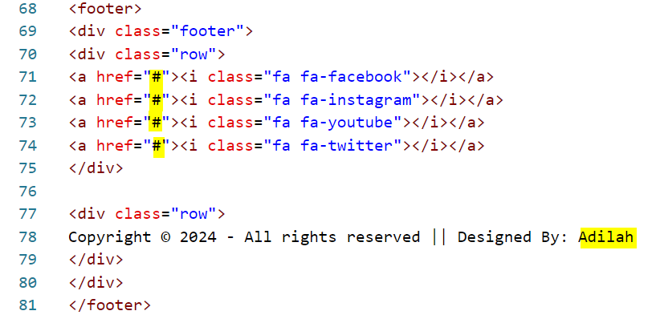
Line 71-74: Insert your social media links. If unavailable just remove the whole line
Line 78: Rename to your name

Slide 14
PERSONAL_DETAILS. HTML

Slide 15
Line 8: Rename your title page
Line 9: Remove all

Slide 16
Line 19: Add your header either in form of image or text

Slide 17
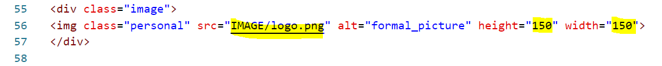
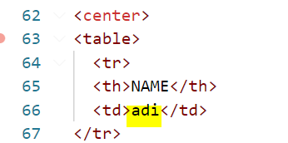
Line 56: Insert your image, adjust height and width based on your preference
Line 63 - 136: Copy from your biodata.html file and paste it in personal_details.html file

Slide 18
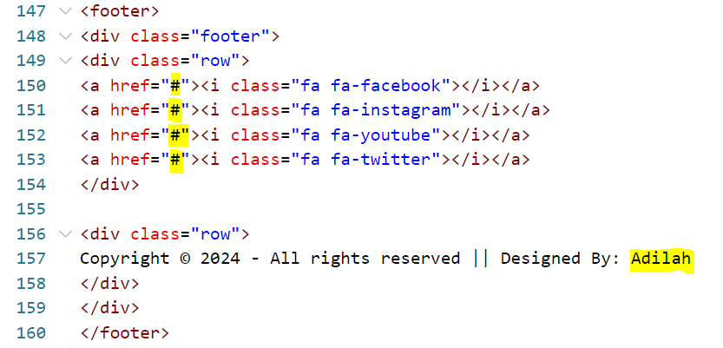
Line 150 - 153: Insert your social media links. If unavailable just remove the whole line
Line 157: Rename to your name

Slide 19
EDUCATIONAL.HTML

Slide 20
Line 8: Rename your title page
Line 9: Remove all

Slide 21
Line 19: Add your header either in form of image or text

Slide 22
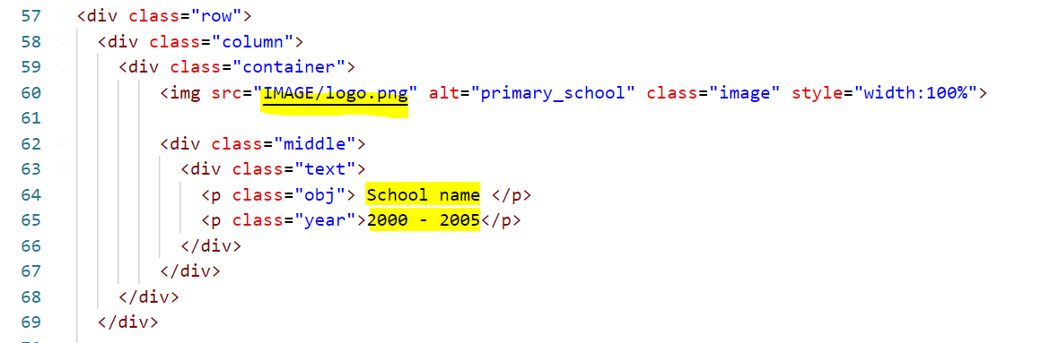
Line 60: Update your image location
Line 64: Rename your primary school name
Line 65: Update your year

Slide 23
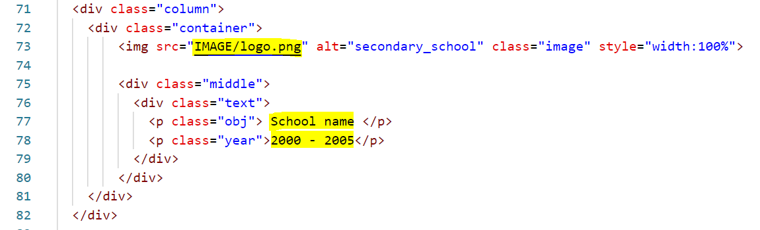
Line 73: Update your image location
Line 77: Rename your secondary school name
Line 78: Update your year

Slide 24
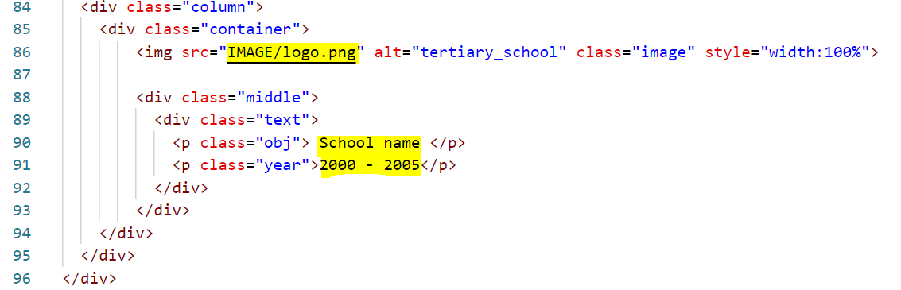
Line 86: Update your image location
Line 90: Rename your uni name
Line 91: Update your year

Slide 25
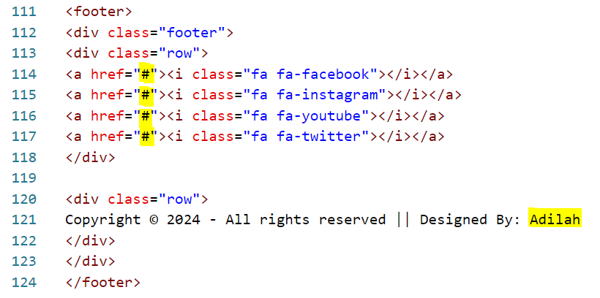
Line 114 - 117: Insert your social media links. If unavailable just remove the whole line
Line 121: Rename to your name

Slide 26
COCU.HTML

Slide 27
Line 8: Rename your title page
Line 9: Remove all

Slide 28
Line 19: Add your header either in form of image or text

Slide 29
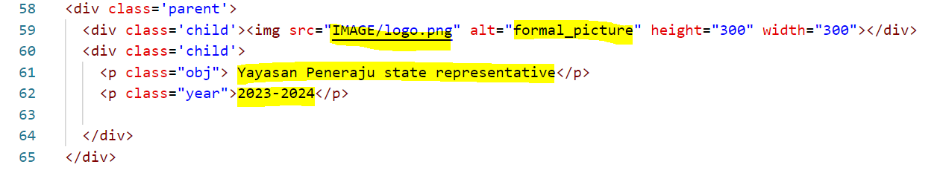
Line 59: Change image location and rename alt name to any relevant name
Line 61 and 62: Edit
*Repeat the same thing to line 68, 70,71, 76, 78,79, 80
*if you need to add more information, copy code from line 58 - 65 and paste at the below.

Slide 30
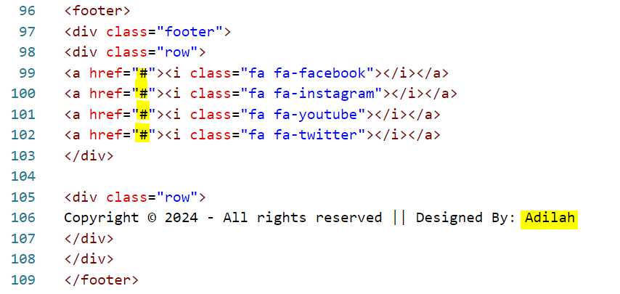
Line 99 - 102: Insert your social media links. If unavailable just remove the whole line
Line 106: Rename to your name

Slide 31
EXPERIENCE.HTML

Slide 32
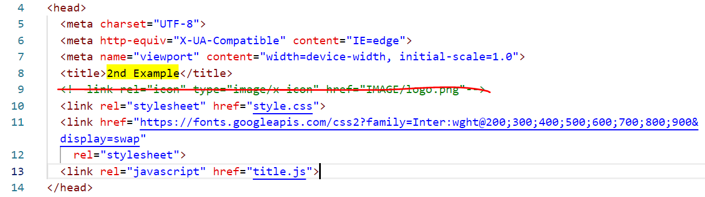
Line 8: Rename your title page
Line 9: Remove all

Slide 33
Line 19: Add your header either in form of image or text

Slide 34
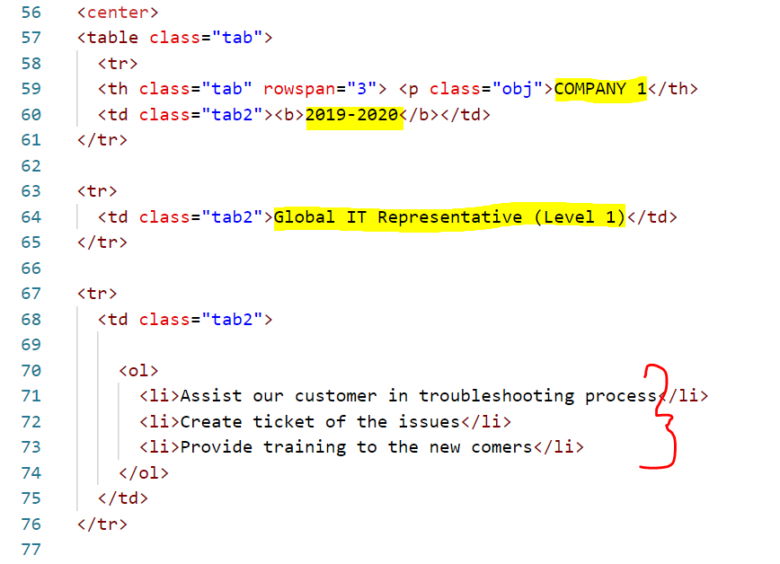
Line 59: Rename your company/office/stall name
Line 60: Year of working
Line 64: Work position
Line 71-73: Roles and responsibilities (u can add the number of list by copy the whole line <li>
*add more columns and rows by copy the whole line 58 - 76

Slide 35
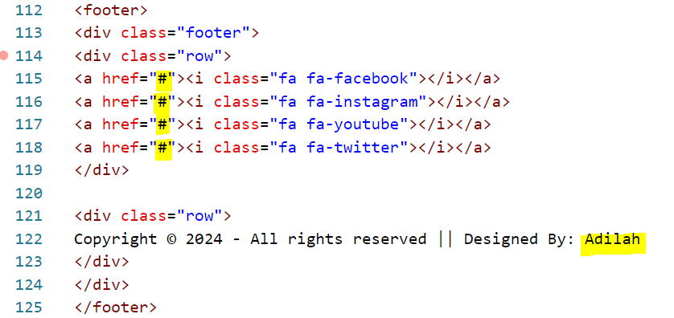
Line 115 - 118: Insert your social media links. If unavailable just remove the whole line
Line 122: Rename to your name

Slide 36
CORE_SKILL.HTML

Slide 37
Line 8: Rename your title page
Line 9: Remove all

Slide 38
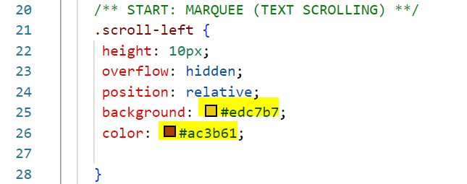
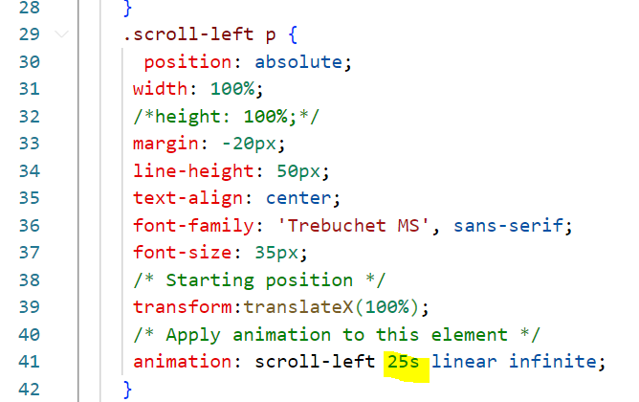
Line 25: background color for scroll text
Lin 26: Font color of scrolling text
Line 41: Adjust speed for text scrolling

Slide 39
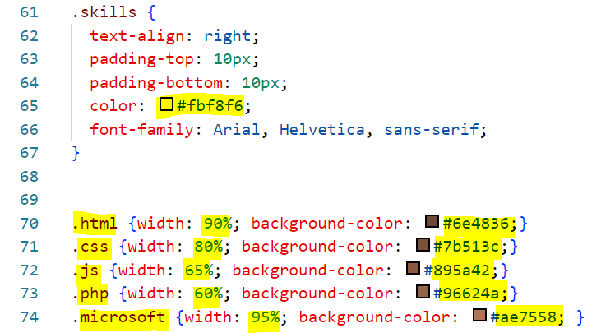
Line 65: Font color in bar chart
Line 70 - 74: Rename your computer skills, update your skill’s percentage and change the bar chart color based on your preference.
*if you need to add more bar chart, copy the whole line 74 and paste below and update skills, percentage and color

Slide 40
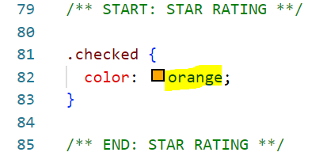
Line 82: star color, u can change based on your preference

Slide 41

Line 138: Add your header either in form of image or text

Slide 42
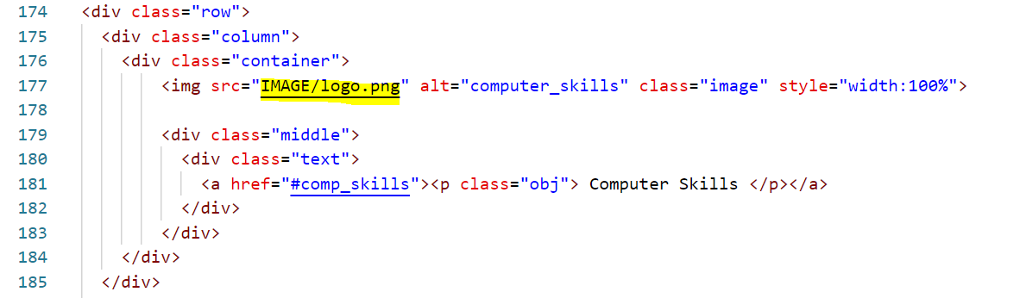
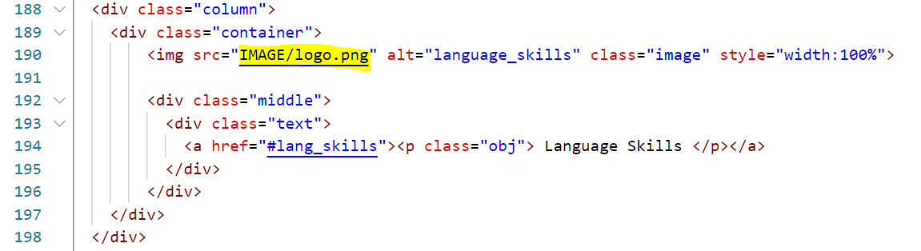
Line 177: Replace your image location address
Line 190: Replace your image location address

Slide 43
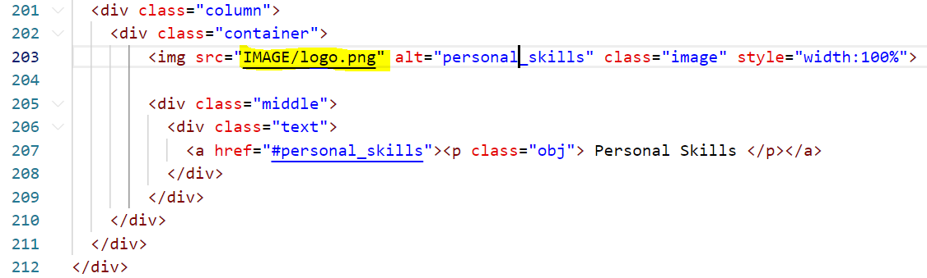
Line 203: Replace your image location address

Slide 44
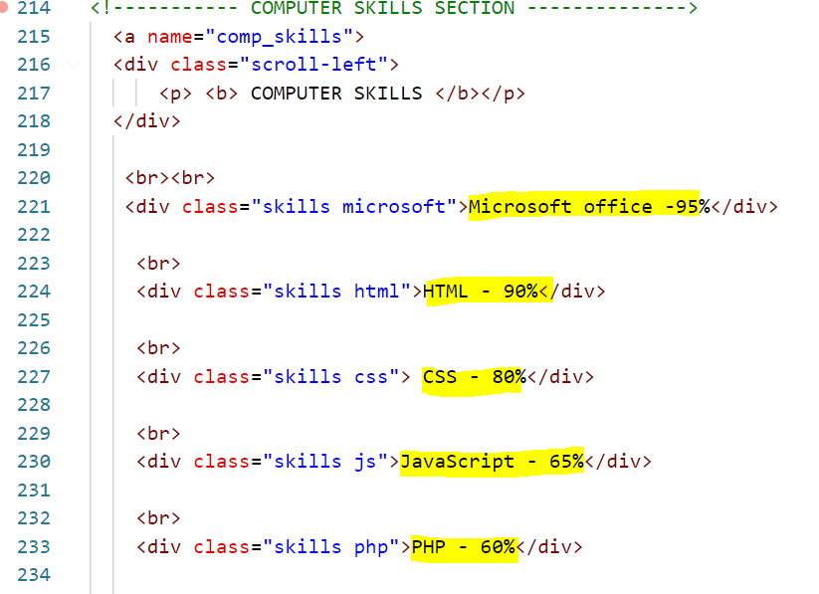
Line 221, 224, 227, 230, 233: Rename with the appropriate name
*Delete unuse line / Add more line if u add more bar chart

Slide 45
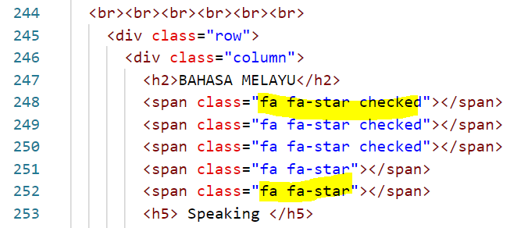
Line 248 - 252: If need to add more colored star just add word “active” after fa fa-star. Refer example line 248

Slide 46
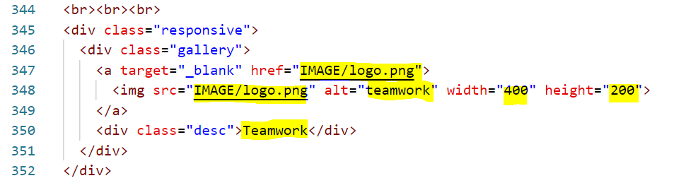
Line 347 & 348: Rename your image location address
Line 348: alt-rename same as description; width and height based on your preference (if u want to change)
* do the same thing until line 378.
* u can add more image by copying the whole line 345 - 352

Slide 47
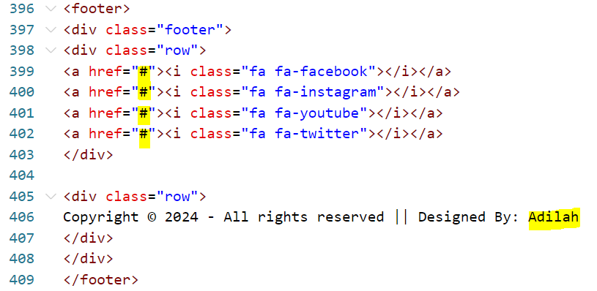
Line 399 - 402: Insert your social media links. If unavailable just remove the whole line
Line 406: Rename to your name

Slide 48
REFERENCES.HTML

Slide 49
Line 8: Rename your title page
Line 9: Remove all

Slide 50
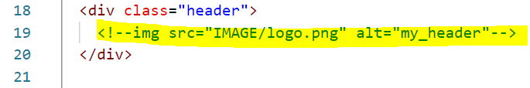
Line 19: Add your header either in form of image or text

Slide 51
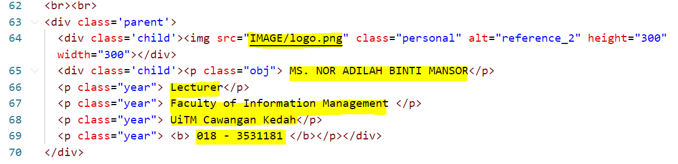
Line 64: replace with your image location address
Line 65 - 69: Edit your 2nd reference information
*u can add 1 more reference by copying the whole line 62 - 70 and paste below

Slide 52
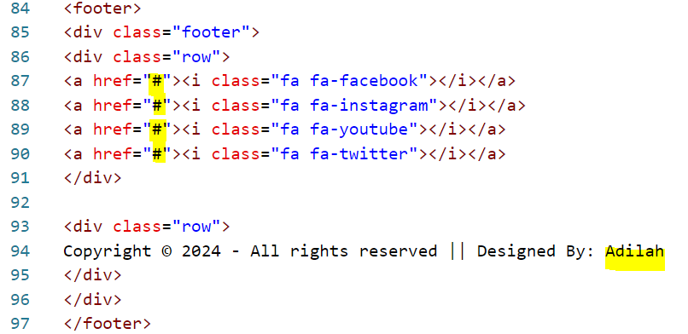
Line 87 - 90: Insert your social media links. If unavailable just remove the whole line
Line 94: Rename to your name

